Slide 1
Day 27
Non-parametric Filters: Particle Filters

Slide 2
Particle Filter
Kalman-like filter – all densities are Gaussian
histogram filter – represent density as histogram over the entire domain of the state
particle filter – represent density as a (large) set of samples drawn from the density
  samples are called particles
  each particle is a concrete instantiation of the state at time t

Slide 3
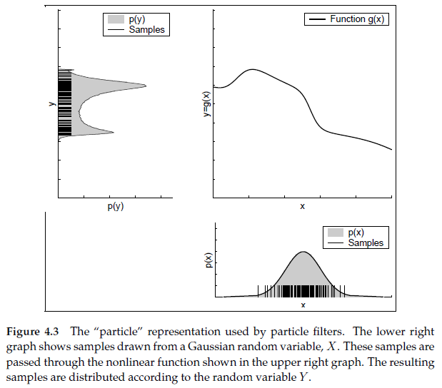
Particle Filter

Slide 4
Particle Filter Localization
consider a robot moving down a hall equipped with a sensor that measures the presence of a door beside the robot
  the pose of the robot is simply its location on a line down the middle of the hall
  the robot starts out having no idea how far down the hallway it is located
  robot has a map of the hallway showing it where the doors are

Slide 5
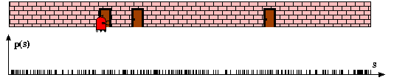
Particle Filter Localization
the robot starts out having no idea how far down the hallway it is located
  particles with equal weights are randomly drawn from a uniform state density
height of particle is proportional to its weight
the weights are called importance weights

Slide 6
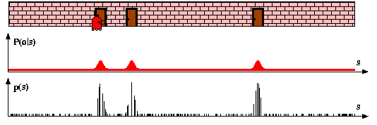
Particle Filter Localization
because the robot is beside a door, it has a measurement
  it can incorporate this measurement into its state estimate
  particles are reweighted based on how consistent each particle is with the measurement
low weight
low weight
low weight

Slide 7
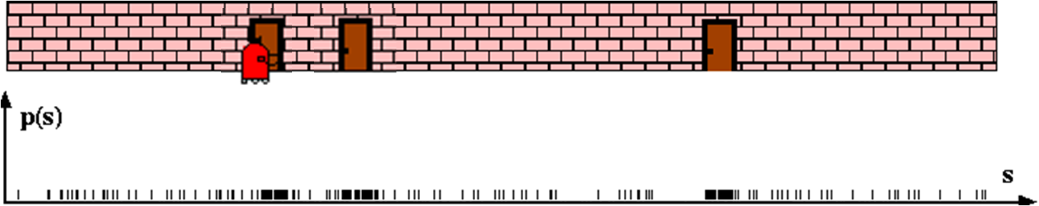
Particle Filter Localization
the existing particles are resampled with replacement where the probability of drawing a particle is proportional to its importance weight
resampling produces a set of particles with equal importance weights that
approximates the density
the resampled set usually contains many duplicate particles (those with high
importance weights)
the resampled set will be missing many particles from the original set (those
with low importance weights)

Slide 8
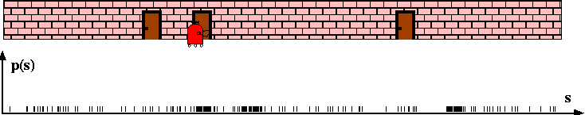
Particle Filter Localization
the particles are projected forward in time using the motion model

Slide 9
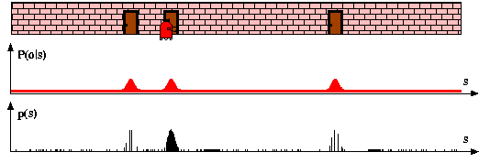
Particle Filter Localization
because the robot is beside a door, it has a measurement
  it can incorporate this measurement into its state estimate
  particles are reweighted based on how consistent each particle is with the measurement

Slide 10
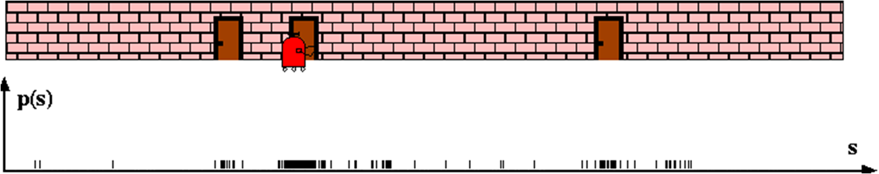
Particle Filter Localization
the existing particles are resampled with replacement where the probability of drawing a particle is proportional to its importance weight

Slide 11
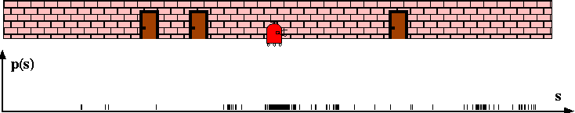
Particle Filter Localization
the particles are projected forward in time using the motion model

Slide 12
Particle Filter Localization Algorithm
algorithm pf_localization( )
empty set
for m = 1 to M
sample_motion_model( )
measurement_model( )
endfor
resample ( )
return
set of particles
control input
measurement
map

Slide 13
Resampling Algorithm
algorithm resample( )
for m = 1 to M
draw i with probability
add to
endfor
return

Slide 14
Drawing Particles
compute this
then this
i | importance weights | cumulative sum | normalized sum
1 | 0.0846 | 0.0846 | 0.0235
2 | 0.0769 | 0.1615 | 0.0449
3 | 0.0895 | 0.2510 | 0.0698
4 | 0.4486 | 0.6995 | 0.1945
5 | 0.9505 | 1.6500 | 0.4588
6 | 0.6019 | 2.2519 | 0.6262
7 | 0.1720 | 2.4239 | 0.6740
8 | 0.2853 | 2.7092 | 0.7534
9 | 0.0301 | 2.7393 | 0.7618
10 | 0.8567 | 3.5960 | 1.0000
then generate M random number uniformly distributed between 0 and 1

Slide 15
Drawing Particles
find the first normalized sum
entry that this is less than
i | importance weights | cumulative sum | normalized sum | random numbers | particle
1 | 0.0846 | 0.0846 | 0.0235 | 0.5261 | 6
2 | 0.0769 | 0.1615 | 0.0449 | 0.5154 | 6
3 | 0.0895 | 0.2510 | 0.0698 | 0.8847 | 10
4 | 0.4486 | 0.6995 | 0.1945 | 0.0286 | 2
5 | 0.9505 | 1.6500 | 0.4588 | 0.3836 | 5
6 | 0.6019 | 2.2519 | 0.6262 | 0.5928 | 6
7 | 0.1720 | 2.4239 | 0.6740 | 0.4528 | 5
8 | 0.2853 | 2.7092 | 0.7534 | 0.3306 | 5
9 | 0.0301 | 2.7393 | 0.7618 | 0.5034 | 6
10 | 0.8567 | 3.5960 | 1.0000 | 0.7134 | 8
this algorithm is known as “roulette wheel sampling/selection”
inefficient as it requires generating M random numbers and M binary searches
“stochastic universal sampling” is often used instead

Slide 16
Sampling Variance
an important source of error in the particle filter is the variation caused by random sampling
whenever a finite number of samples is drawn from a probability density, the statistics extracted from the samples will differ slightly from the statistics of the original density
  e.g., if you draw 2 samples from a 1D Gaussian and compute the mean and variance you will probably get a different mean and variance from the original probability density
    however, if you draw 100 samples then the mean and variance will probably be very close to the correct values

Slide 17
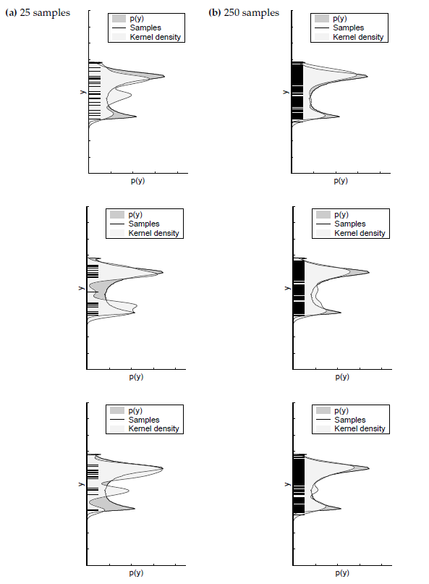
Sampling Variance

Slide 18
Resampling Issues
there are many issues related to resampling and how to perform good resampling
notice that resampling as we have described it causes some particles to be eliminated and some to be duplicated
  continuous resampling will eventually cause all of the particles to be duplicates of a small number of states
  some PF implementations will add a small amount of noise to the particles so that they are not exact duplicates

Slide 19
Particle Deprivation
it may happen that there are no particles near the correct state
  this can happen because of the variance in random sampling
    an unlucky series of random numbers can wipe out all of the particles near the correct state
  when this occurs the filter estimate can become arbitrarily incorrect
occurs mostly when the number of particles is too small for the dimensionality of the state

